Slide 1
EDA
Team member: Yu Zhu Ou, Aidana Almazbek kyzy

Slide 2
The dataset covers 97 ZIP codes over 35 days, with about 79,000 observations and 191 features.
The goal of this phase is to check data quality, understand patterns, and prepare for modeling.

Slide 3
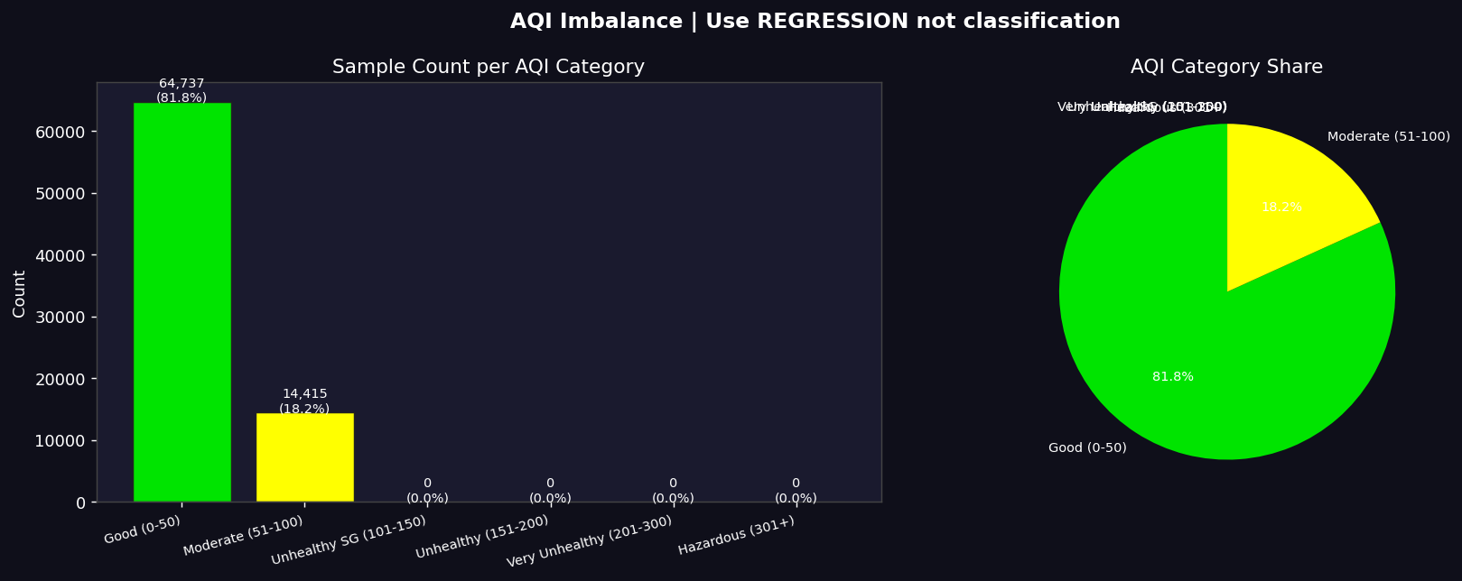
From Figure 3, we observe that AQI values are only in the Good and Moderate range.
So this confirms that we should treat this as a regression problem, not classification.

Slide 4
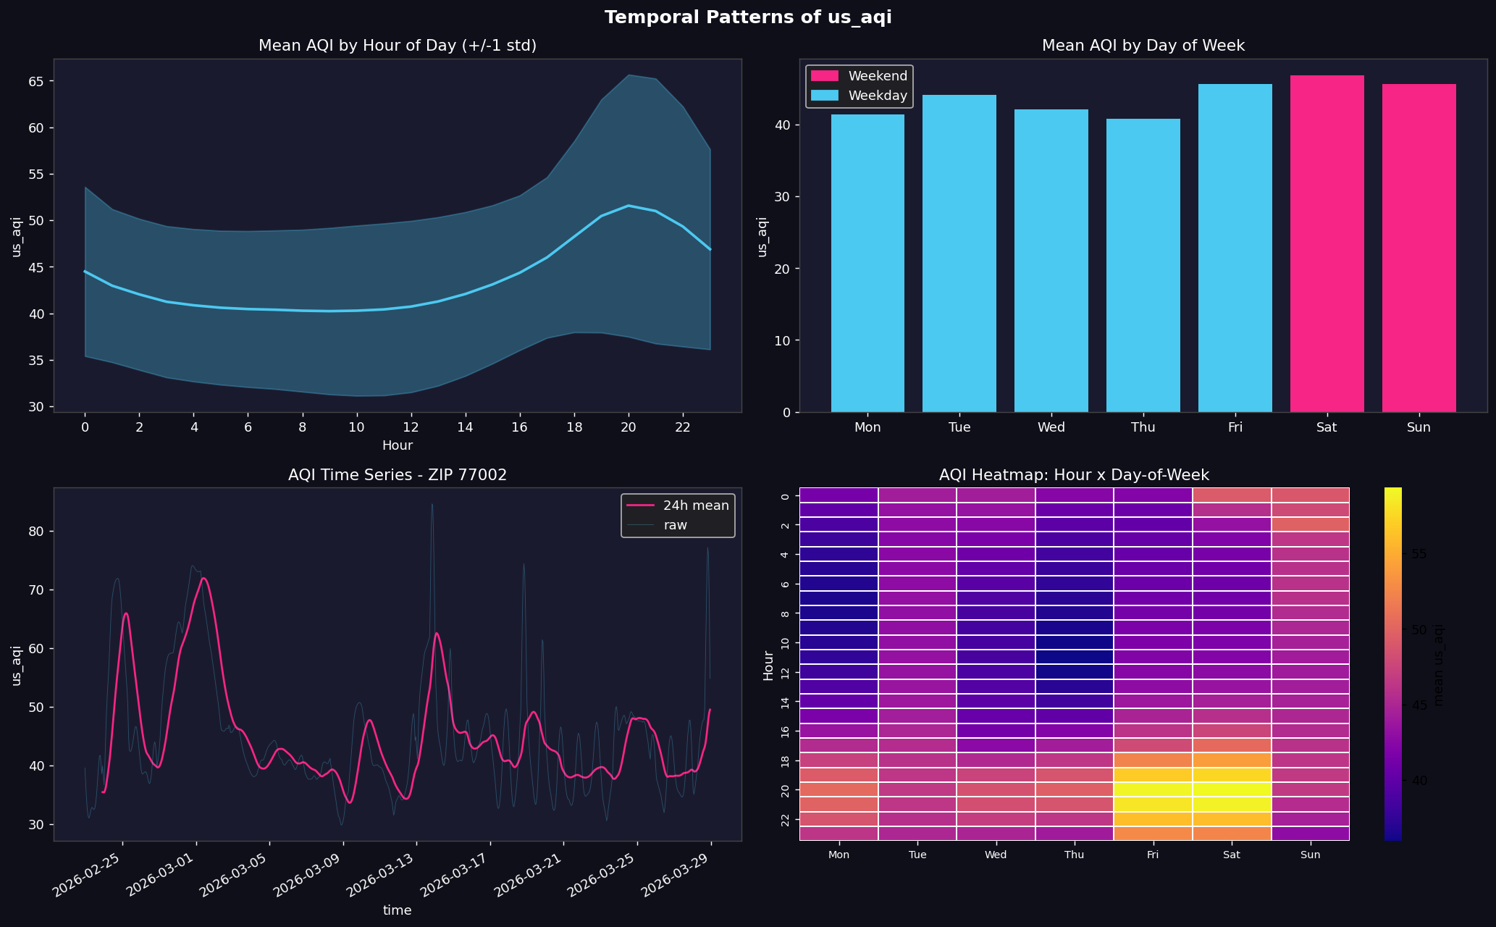
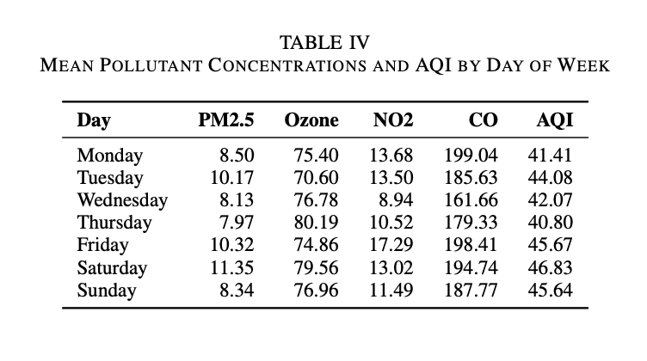
From Figure 4 and Table IV, we see strong temporal patterns.
AQI is lowest in the morning and reaches its peak around 8 PM.
Also, AQI is higher on Fridays and Saturdays. This suggests that human activity, especially traffic and daily routines, has a strong impact on air quality.

Slide 5
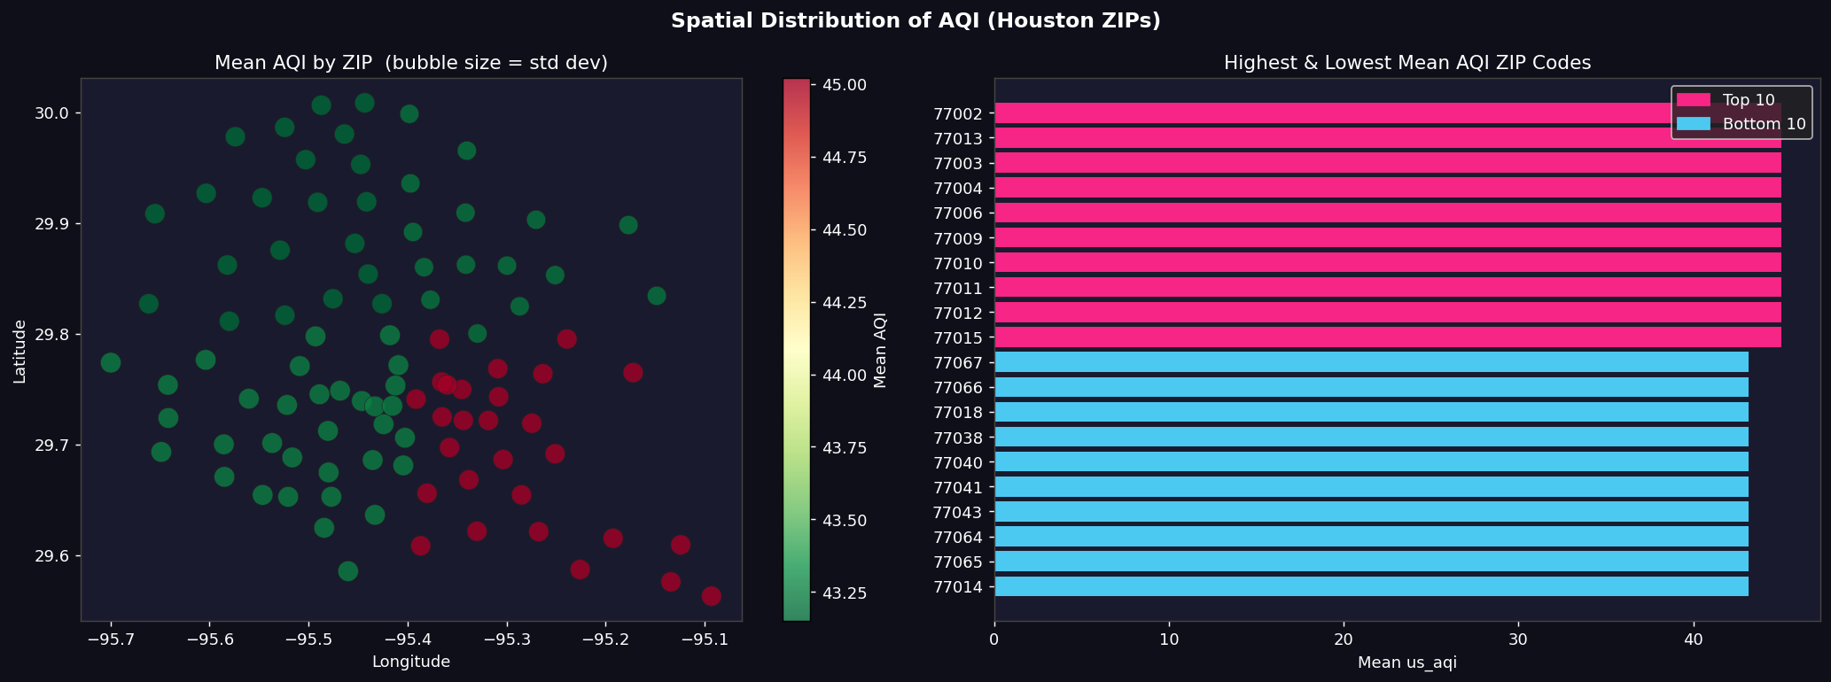
Looking at spatial patterns in Figure 6, AQI is quite similar across different ZIP codes.
This means location does have some effect, but it is weaker compared to time.

Slide 6
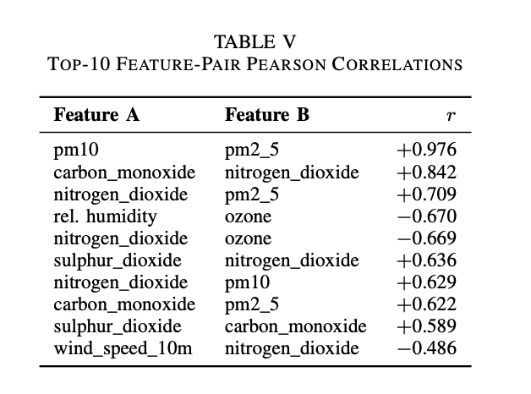
From the correlation table, we find that PM2.5 and PM10 are highly correlated, so one of them should be removed to avoid redundancy.
We also see strong relationships between carbon monoxide and nitrogen dioxide, which suggests they come from similar sources like traffic or combustion.

Slide 7
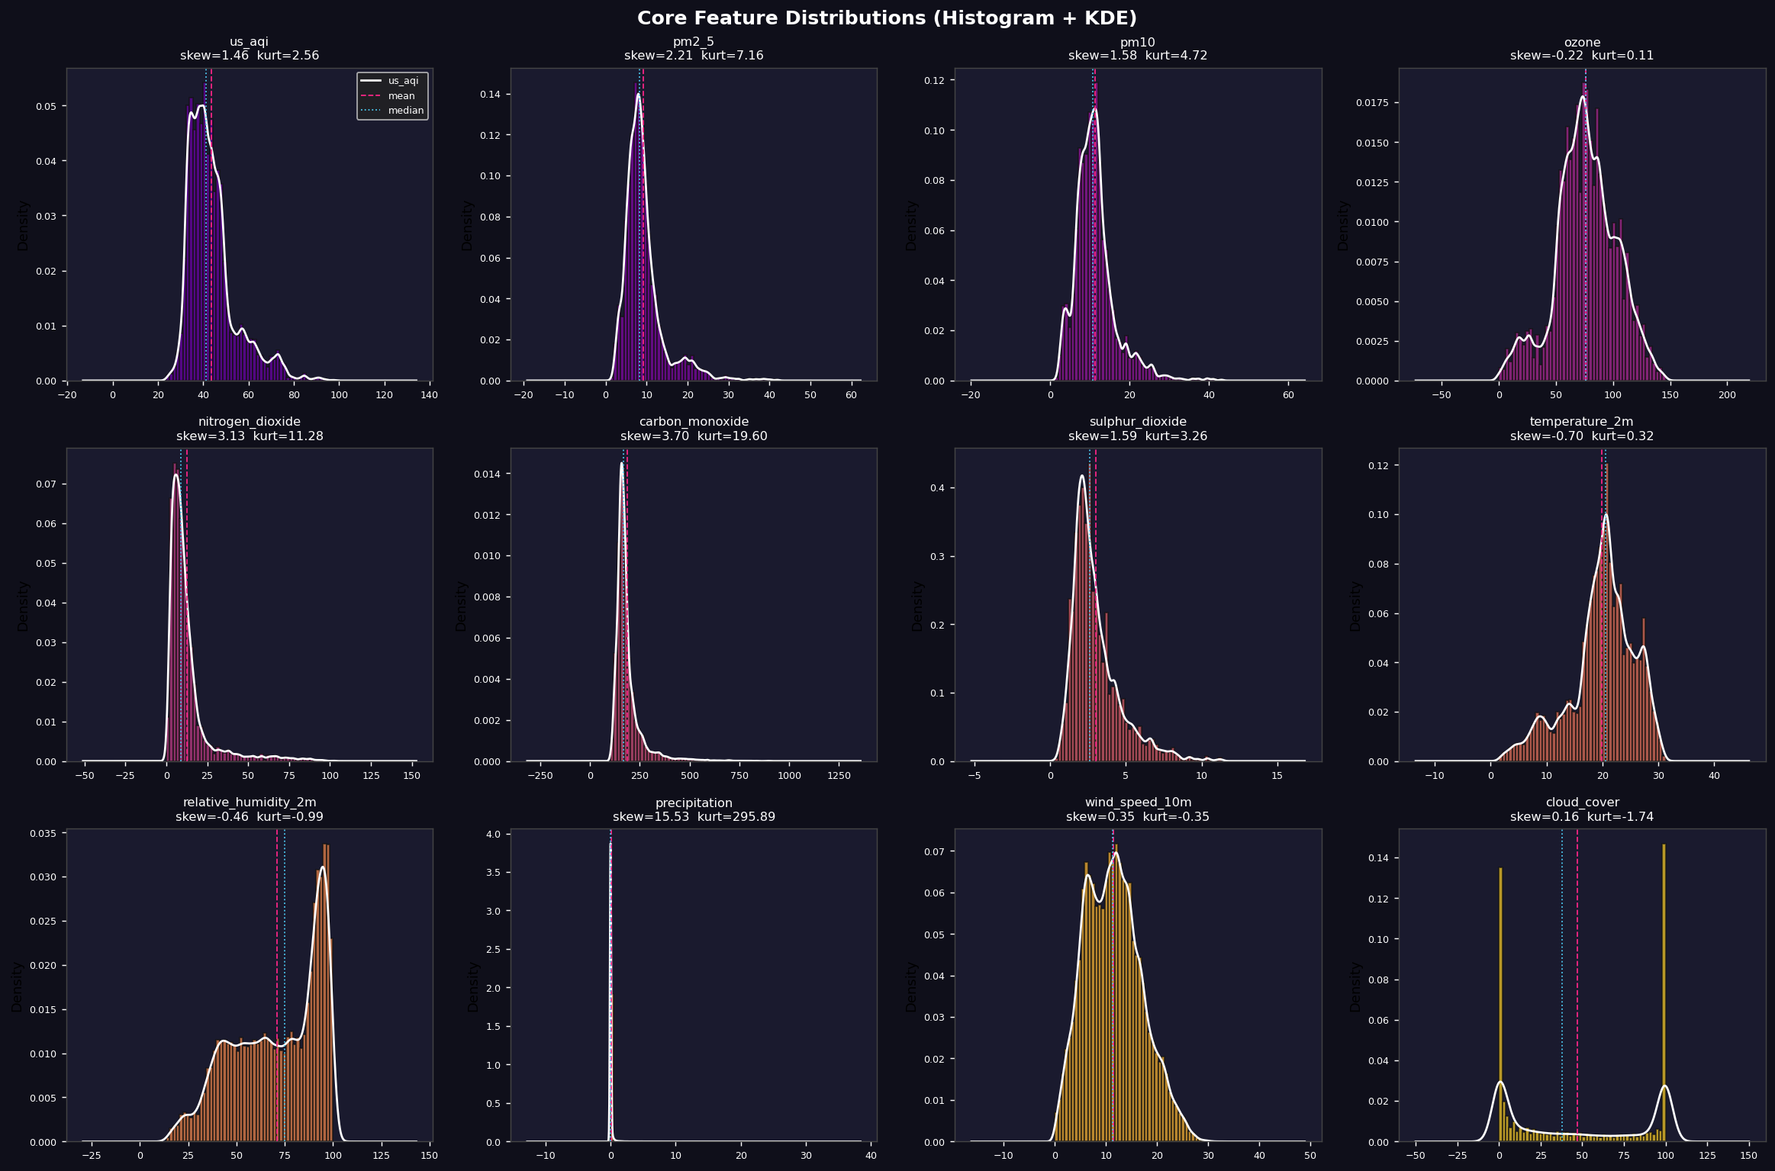
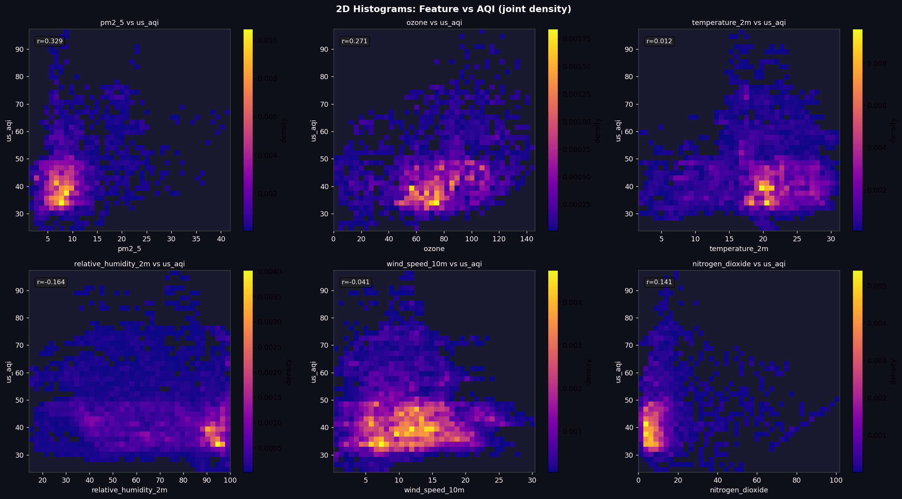
“From the distribution and density plots, many variables are skewed, and the relationships are not linear.
This tells us that simple linear models may not perform well.”

Slide 8
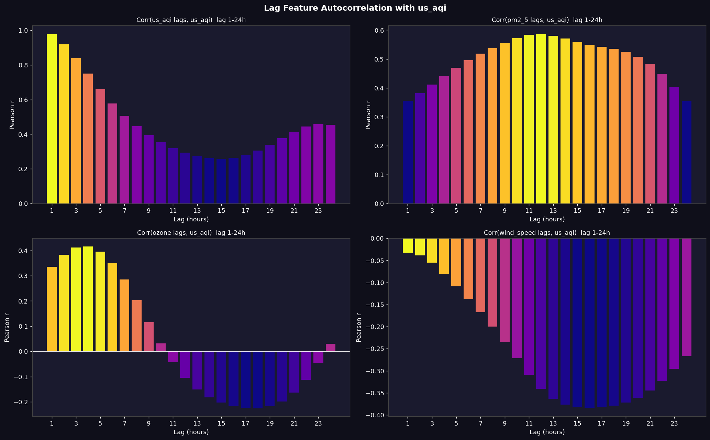
The most important result comes from Figure 15. We found that AQI at the previous hour has a correlation of 0.977 with the current AQI.
This is extremely high, which means AQI strongly depends on its past values. So this is clearly a time-series problem.

Slide 9
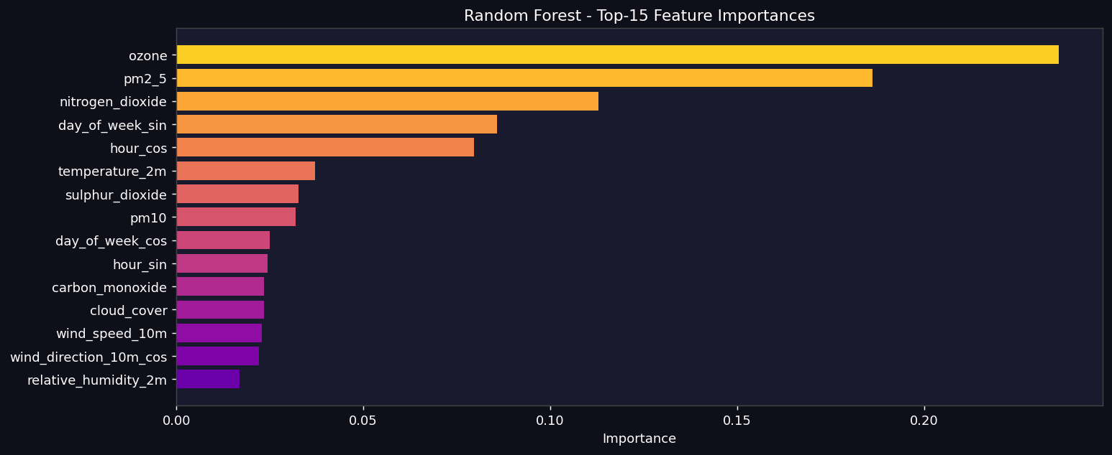
From the feature importance table, the most important predictors are ozone, PM2.5, and nitrogen dioxide(NO₂), along with time-related features like hour and day.

Slide 10
During this phase, one challenge was handling a large dataset with many features, especially lag features.
We validated our analysis by checking data quality, distributions, and consistency across features.
Our work supports the modeling team by identifying key patterns, important features, and relationships needed for prediction.
We contribute to accuracy by identifying non-linear patterns and key predictors, which helps improve model performance.

